Slide 1
Collection Types

Slide 2
Collection Types
Imagine you want to store the names of 10 major cities. For this, you may need to declare 10 string variables to store the names. Things will be complicated if more variables need to be stored and manipulated.
Storing and manipulating values grouped in a collection makes the work easier.
Three primary collection types provided by swift are,
Arrays
Dictionaries
Sets

Slide 3
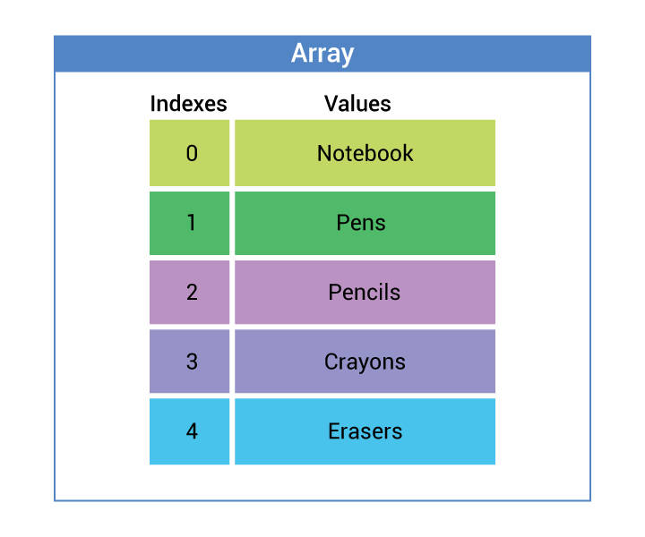
Arrays

Slide 4
Array Creation
Arrays are ordered collections of values of the same type. Arrays can contain duplicate values.
Arrays can be created in several ways:
Create an empty array for storing Integers
var rollNumbers = [Int]()
Create an immutable array
let fruits: [String] = ["Apple", "Orange", "Mango"]
Create mutable array
var cities = ["San Francisco","Cupertino","Washington"]

Slide 5
Operations / Manipulation
Counting number of cities
var cities = ["San Francisco","Cupertino","Washington"]
let cityCount = cities.count
Check if an array is empty
var cities = ["San
Francisco","Cupertino","Washington"]
if cities.isEmpty {
print("Empty")
}else{
print("Not Empty")
}

Slide 6
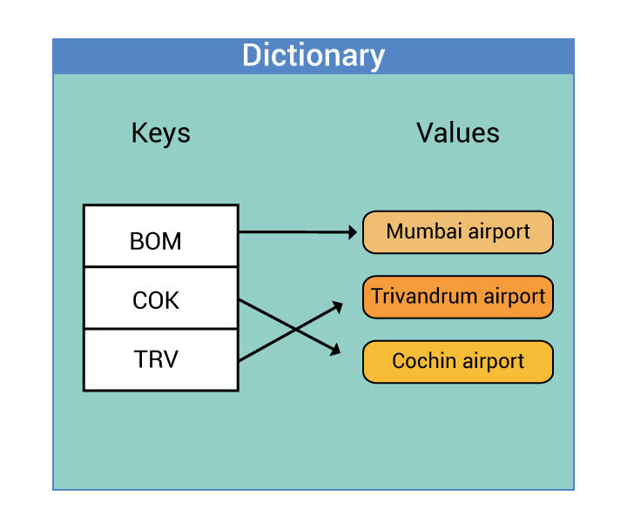
Dictionary

Slide 7
Dictionary Creation
A dictionary stores an unordered collection of values.
Each value in the dictionary is associated with a unique key. The key is an identifier for a value within the dictionary.
Creating a dictionary
Key as integer and value as string
var names2: [Int: String]
Using literals
var totalMarks = ["John":300, "Ann":800, "Tom":500]

Slide 8
Operations
Read value for a key
var totalMarks = ["John":300, "Ann":800, "Tom":500]
if let mark = totalMarks["Tom"] {
print("Tom's mark is", mark)
}

Slide 9
Sets
A set is an unordered collection of distinct values. Set does not allow duplicates.
Creating a Set
var set1 = Set<String>()
var foodSet: Set = ["Salad", "Soup", "Chips"]
Operations: Add new value
var foodSet: Set = ["Salad", "Soup", "Chips"]
foodSet.insert("Pasta")

Slide 10
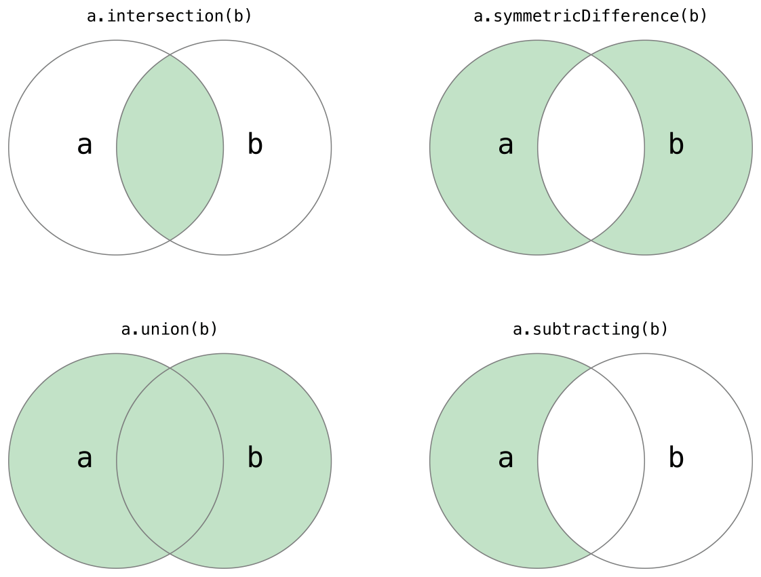
Set Operations

Slide 11
Set Operation Example
Use the intersection(_:) method to create a new set with only the values common to both sets.
Use the symmetricDifference(_:) method to create a new set with values in either set, but not both.
Use the union(_:) method to create a new set with all of the values in both sets.
Use the subtracting(_:) method to create a new set with values not in the specified set.
let oddDigits: Set = [1, 3, 5, 7, 9]
let evenDigits: Set = [0, 2, 4, 6, 8]
let singleDigitPrimeNumbers: Set = [2, 3, 5, 7]
oddDigits.union(evenDigits).sorted()// [0, 1, 2, 3, 4, 5, 6, 7, 8, 9]
oddDigits.intersection(evenDigits).sorted()// []
oddDigits.subtracting(singleDigitPrimeNumbers).sorted()// [1, 9]
oddDigits.symmetricDifference(singleDigitPrimeNumbers).sorted()// [1, 2, 9]

